Slide 1

Airbnb Price Predictions – 03/25/21
Kapil Pundhir, Hillary Mandich, Cecilia Leung, Amaris Hassan, Caitlan Beachey

Slide 2

Airbnb Pricing Background
Notes:
This table shows you the coefficient of correlation (R2) & Mean Squared Error (MSE)
The r2 tells you how close the data fits to the regression line. MSE is the squared average difference between the actual & predicted values.
Based on the model, it tells us that the time trends have the strong impact on the price. The features have a moderate correlation to the price and the clustering have a fairly weak correlation

Slide 3
Exploratory Questions
Notes:
This table shows you the coefficient of correlation (R2) & Mean Squared Error (MSE)
The r2 tells you how close the data fits to the regression line. MSE is the squared average difference between the actual & predicted values.
Based on the model, it tells us that the time trends have the strong impact on the price. The features have a moderate correlation to the price and the clustering have a fairly weak correlation

Slide 4
Project process
Notes:
We have the following tables in our existing database. To strengthen our price model, we added 3 new tables to see how different factors like monthly, day of week & predicted prices can help hosts price their Airbnb units

Slide 5
Dashboard Outputs
Notes:
We have the following tables in our existing database. To strengthen our price model, we added 3 new tables to see how different factors like monthly, day of week & predicted prices can help hosts price their Airbnb units

Slide 6
Database Change
EXISTING
NEW
Listings Masters
Borough ID
Neighbourhood ID
Room Type ID
Yearly Rates
Monthly Rates
Day of Week Rates
Predicted Rates
Notes:
We have the following tables in our existing database. To strengthen our price model, we added 3 new tables to see how different factors like monthly, day of week & predicted prices can help hosts price their Airbnb units

Slide 7
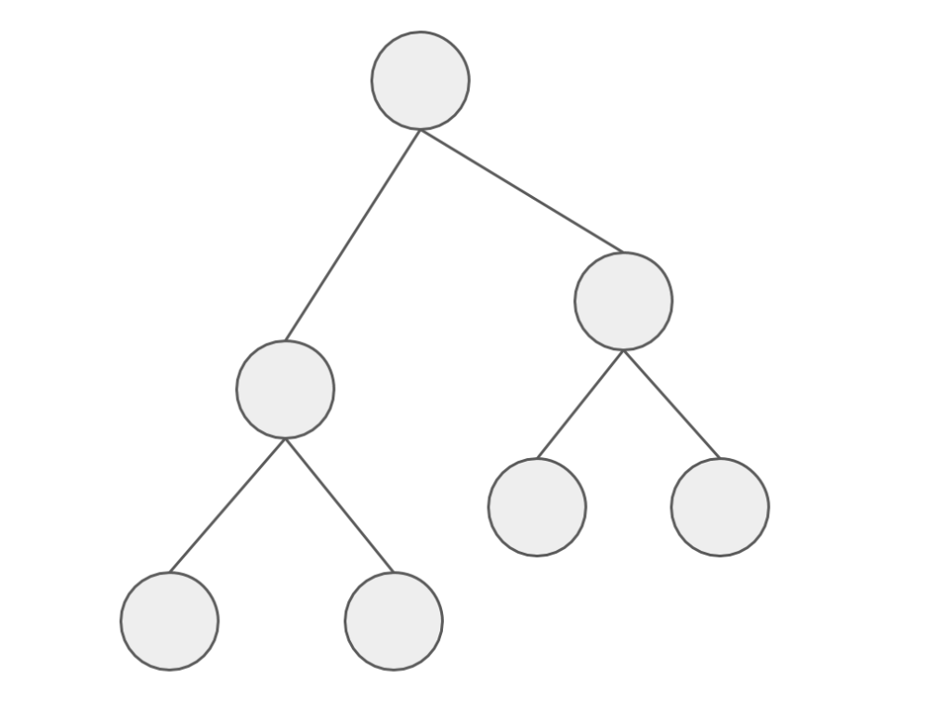
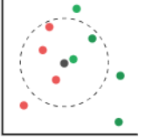
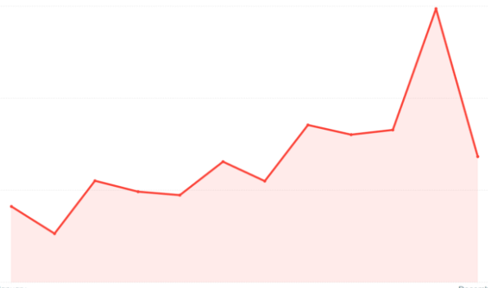
Price Predictor Regression Models
Random Forest
LGBM
KNN
Facebook Prophet
Notes:
To predict prices, we decided to use the Random Forest & LGBM Regressor methods to determine which features are the most important to price an AirBNB.
We then use the KNN Regressor to see how the price is affected with having listings close to your area.
Finally, we used the Facebook Prophet to how prices are affected by time & seasonality to predict Airbnb future prices.

Slide 8
Model Findings
Important Features for Pricing
Neighbourhood
Room Type
Bathrooms
Highest Price Correlation
Number of People Listings can Accommodate
Number of Bedrooms
Low-Moderate Correlation on Clustering
Prices fluctuate during different times of the year.
More uncertainty in the prices for the future.
Hosts should consider pricing their units at different rates during different times of the year.
Wider range of upper and lower limit further away in the future when predicting future prices for the unit.
Room Type & Location are two of the most important features in pricing your listing.
Number of people accommodate
Room Type and Location a
Hosts can charge more with more amenities
Model shows that number of reviews and review scores do not have a high correlation to price and is not a top 5 feature
Nearest Neighbours do not have a strong impact on price. This maybe due to the dataset having a wide variety of room types with different room numbers.
Notes:
This table shows you the coefficient of correlation (R2) & Mean Squared Error (MSE)
The r2 tells you how close the data fits to the regression line. MSE is the squared average difference between the actual & predicted values.
Based on the model, it tells us that the time trends have the strong impact on the price. The features have a moderate correlation to the price and the clustering have a fairly weak correlation

Slide 9
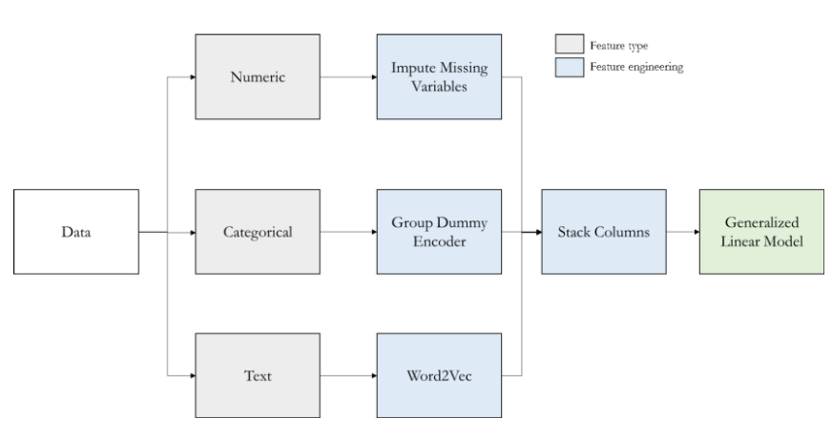
Model Data Transformation – RF, LGBM, KNN
Note: Used for Random Forest, LGBM and KNN Regressor Models only
Notes:
This table provides an overview of what we need to do to try to find the best fit for the model. The next few slides will provide a breakdown of what we did to transform the data.

Slide 10
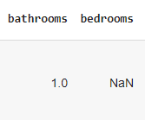


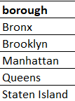
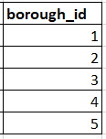

Model Data Transformation - RF, LGBM, KNN
1. Imputing Missing Numerical Data
2. Encoding Categorical Data
3. Vectorizing Text Data
Notes:
First, we needed to replace the blank fields with the averages for that specific column
Second, we need to put the data by categorize our data by numerical values which was done from our last project for boroughs, neighbourhoods & room type.
Then we also, vectorize the most important amenities to get a count for each listing.

Slide 11
Model Data Cleaning – Adding Columns
How will this new feature will impact the price?
amenities
[“Wifi”, “Kitchen”, “Heating”, “Air Conditioning]
amenities_count
4
Notes:
Before we actually run the model, we have to clean the database by adding certain information that may add value to our findings.
So we added the amenities count column because we believe that it has a positive correlation to the listing price.

Slide 12
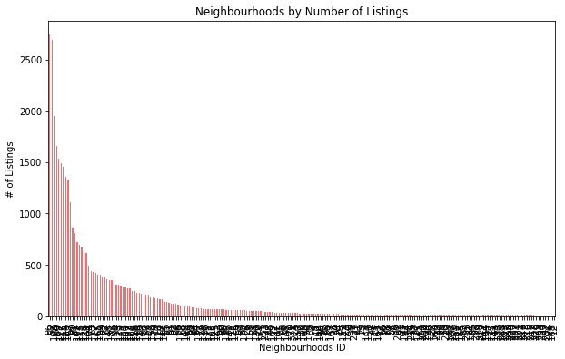
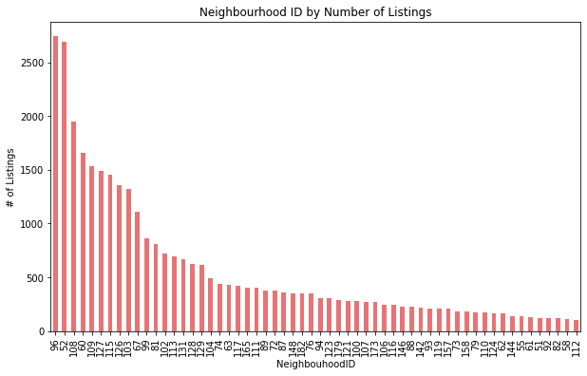
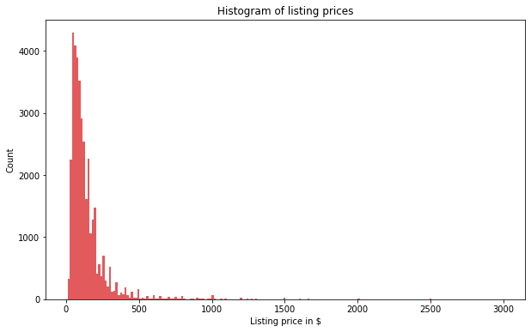
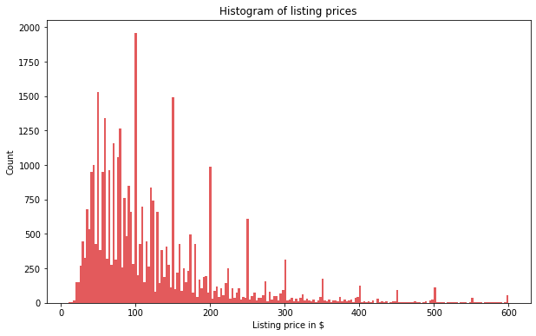
Model Data Transformation - RF, LGBM, KNN
4. Removing Outliers
Filter for:
1. ≥100 Listings
2. ≤ $600/night
Notes:
To get the best selection of listings that best represents NYC Airbnb market, 2e filtered out the outliers by only keeping the neighbourhoods that with over 100 listings & the listing prices under $600 so it is more normally distributed.

Slide 13
Model Data Transformation – FB Prophet
Listings Masters
Historical Rates
Holiday Dates
Existing
New
Prophet Model Datasets
Notes:
The facebook prophet runs differently than the other regressor model, so we need to create another dataset for this.
We used our existing data to find the listings masters data to get the borough and room type.
Then we need to created new datasets to find all the historial rates & holiday dates from 2017-2021. All this information is found on the inside Airbnb & us holiday calendar website.
Various methods like concatenation, filtering, merging, renaming columns and calculating the mean were used in Pandas to get our Final output
We believe that putting all of this together can help us accurately predict prices based on location, size, trends and seasonality.

Slide 14
Model Data Preprocessing
RF, LGBM, KNN Regressors
Define features (X-value) that have the most impact on the price (y-value)
Change test data size from 25% to 35% to provide more data to increase accuracy of the models.
Scale the X-values for normalizations to ensure all features are the same unit.
FB Prophet
Add the holiday features, borough and room type information to predict prices.
Notes:
The next step is that we need to select the right features that impact the price. We collectively agreed that features like location, the room type, # of bedrooms/bathrooms, amenities count review scores, # of reviews are some of the major driving force that impacts what the hosts charge for their Airbnb.
Then we increased the dataset size by 10% so that more listing simples can be tested to increase the accuracy of the test scores.
We must ensure that all x-values need to be scaled to the same unit so that it doesn’t give us the wrong scorres.
As for the prophet model, we added the holiday feature, borough and room type info form the original default code we have to
find the optimal train-test data split and to normalize the X-values so that they are in the same units for the model to produce to correct results.

Slide 15
Model Data Challenges
There is no such thing as a perfect dataset for the project.
Large datasets slows down the process.
Limited Connections to run the free version of the PostgreSQL.
Requires many trial runs to select the right features to find the best fit for the model.
Time Consuming to run the Hyperparameter Tuning for the test results as many combinations are tested to determine the overall test score.
Notes:
There is never the perfect dataset for the project… requires lots of cleaning, transformation & formatting to make it useful for our project.
Large datasets slows down the process as it has lots of memory which will slow down the system. It will take longer for you to get the desired output.
The database have limited connection pr

Slide 16
Model Results
 | Random Forest (Features) | LGBM (Features) | KNN (Clustering) | FB Prophet (Seasonality Trends)
R² | 53% | 56% | 41% | 84%
MSE | 62.1 | 60.3 | 69.9 | 31.8
R2 = Coefficient of Correlation
MSE = Mean Squared Error
Notes:
This table shows you the coefficient of correlation (R2) & Mean Squared Error (MSE)
The r2 tells you how close the data fits to the regression line. MSE is the squared average difference between the actual & predicted values.
Based on the results, it tells us 3 things:
FB Prophet has the highest R-squared score and lowest MSE. This indicatesthat timing has a strong impact to the price. The host can consider pricing them differently on the day of the week, month, seasons & holidays.
Having more features/amenities can help you increase the price too with the correlation being over 50%. However, another factor to consider is that
Surprisingly, the KNN score is quite low,

Slide 17
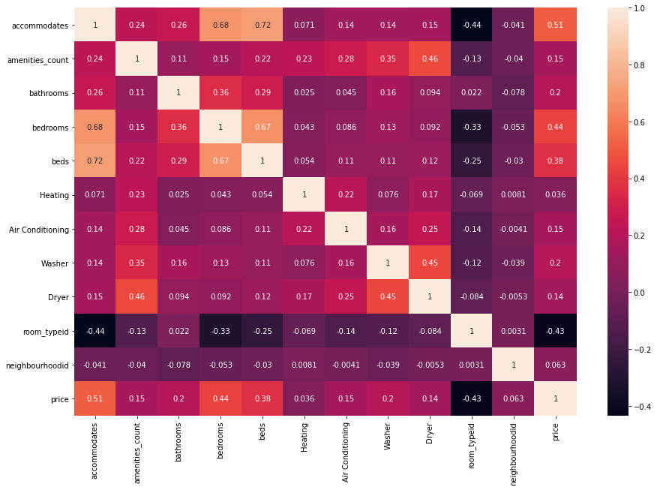
Model Results - Price Correlation
Accommodates
Bedrooms
Beds
Bathroom
Amenities Count
Notes:
This table shows you the coefficient of correlation (R2) & Mean Squared Error (MSE)
The r2 tells you how close the data fits to the regression line. MSE is the squared average difference between the actual & predicted values.
Based on the model, it tells us that the time trends have the strong impact on the price. The features have a moderate correlation to the price and the clustering have a fairly weak correlation

Slide 18
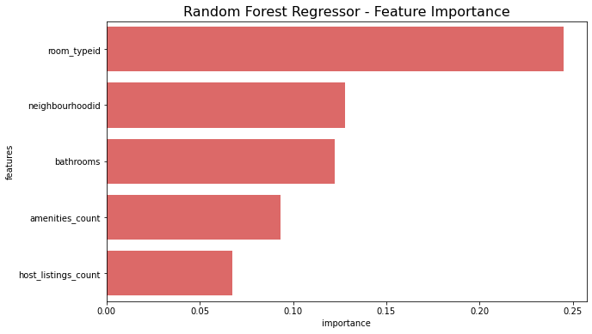
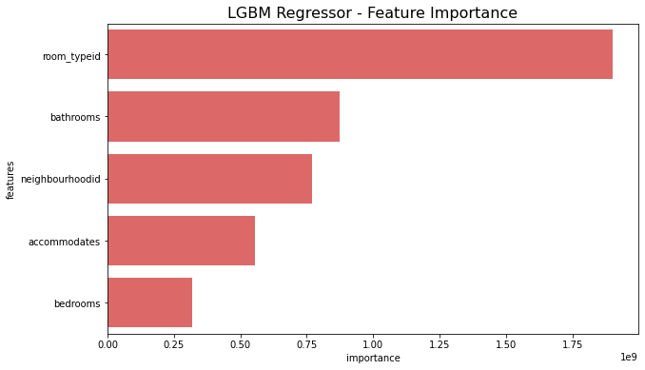
Model Results - Features
Notes:
This table shows you the coefficient of correlation (R2) & Mean Squared Error (MSE)
The r2 tells you how close the data fits to the regression line. MSE is the squared average difference between the actual & predicted values.
Based on the model, it tells us that the time trends have the strong impact on the price. The features have a moderate correlation to the price and the clustering have a fairly weak correlation

Slide 19
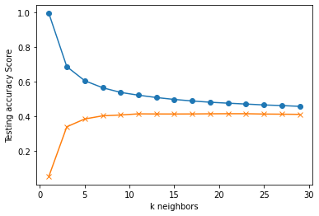
Model Results – Nearest Neighbours
Notes:
This table shows you the coefficient of correlation (R2) & Mean Squared Error (MSE)
The r2 tells you how close the data fits to the regression line. MSE is the squared average difference between the actual & predicted values.
Based on the model, it tells us that the time trends have the strong impact on the price. The features have a moderate correlation to the price and the clustering have a fairly weak correlation

Slide 20
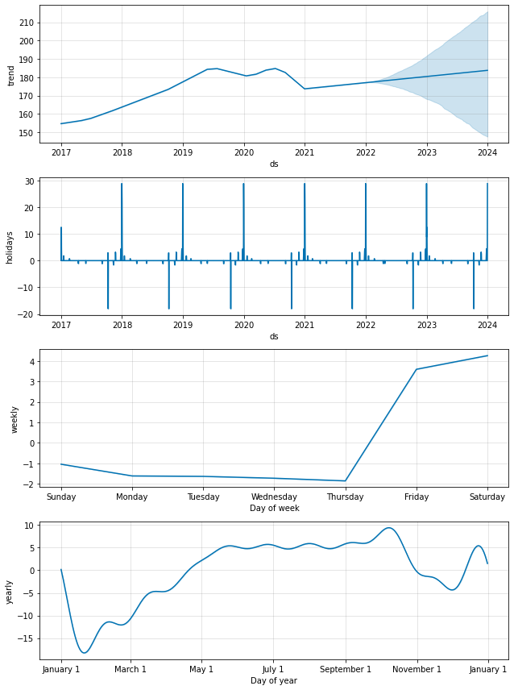
Model Results – Trends & Seasonality
Notes:
This table shows you the coefficient of correlation (R2) & Mean Squared Error (MSE)
The r2 tells you how close the data fits to the regression line. MSE is the squared average difference between the actual & predicted values.
Based on the model, it tells us that the time trends have the strong impact on the price. The features have a moderate correlation to the price and the clustering have a fairly weak correlation

Slide 21
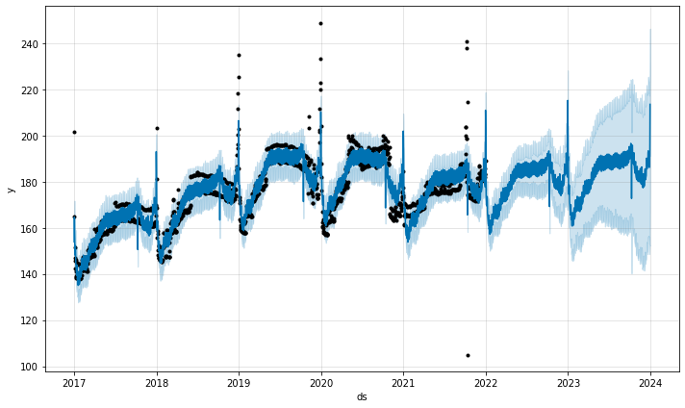
Model Results – Predict the Future
Notes:
This table shows you the coefficient of correlation (R2) & Mean Squared Error (MSE)
The r2 tells you how close the data fits to the regression line. MSE is the squared average difference between the actual & predicted values.
Based on the model, it tells us that the time trends have the strong impact on the price. The features have a moderate correlation to the price and the clustering have a fairly weak correlation

Slide 22
Pricing Considerations
Price the units at different rates during different times of the year.
Hosts can determine the pricing range based on the location and the size of their unit.
Prices can increase with more bedrooms & bathrooms.
Hosts can charge a bit more by providing more amenities.
Do extensive research on how neighbours price their units considering the room type they have.
Notes:
This table shows you the coefficient of correlation (R2) & Mean Squared Error (MSE)
The r2 tells you how close the data fits to the regression line. MSE is the squared average difference between the actual & predicted values.
Based on the model, it tells us that the time trends have the strong impact on the price. The features have a moderate correlation to the price and the clustering have a fairly weak correlation

Slide 23
Final Price Predictor Model
Modified Facebook Prophet Model that predict prices :
From 2017 - 2023
By Boroughs
By Room Type
Show Dashboard Image
Notes:
This table shows you the coefficient of correlation (R2) & Mean Squared Error (MSE)
The r2 tells you how close the data fits to the regression line. MSE is the squared average difference between the actual & predicted values.
Based on the model, it tells us that the time trends have the strong impact on the price. The features have a moderate correlation to the price and the clustering have a fairly weak correlation

Slide 24
Next Steps
Use AWS for the ETL to increase processing time
Add Neighbourhood Feature in the Prophet Model
Explore other Regressor Models
Webscrape New York City news info and include in Dashboard
Notes:
This table shows you the coefficient of correlation (R2) & Mean Squared Error (MSE)
The r2 tells you how close the data fits to the regression line. MSE is the squared average difference between the actual & predicted values.
Based on the model, it tells us that the time trends have the strong impact on the price. The features have a moderate correlation to the price and the clustering have a fairly weak correlation

Slide 25
Dashboard Demo
Notes:
This table shows you the coefficient of correlation (R2) & Mean Squared Error (MSE)
The r2 tells you how close the data fits to the regression line. MSE is the squared average difference between the actual & predicted values.
Based on the model, it tells us that the time trends have the strong impact on the price. The features have a moderate correlation to the price and the clustering have a fairly weak correlation

